Slide 1
2024 SKILLS CANADA Territorial Competition
92-Workplace Safety Secondary Level

Slide 2
Contest Description Document
PURPOSE OF THE CHALLENGE
The intent of the challenge is to assess competitors understanding of OHS principles and ability to perform OHS related duties, including:
• Identifying hazards, recommending and identifying existing control measures
• Displaying an understanding of hazard control
• Effectively communicating OHS information
Skills and Knowledge to be tested.
• Knowledge of OHS principles
• Ability to identify and assess workplace hazards and to recommend corrective action
• Ability to recognize and discuss hazard controls
• Ability to effectively communicate OHS information

Slide 3
1. Hazard Identification:
A fundamental principle of Occupational Health and Safety is recognizing, assessing and controlling hazards in the workplace.
The Hazard Identification activity requires the competitor to demonstrate these skills by assessing, and suggesting controls for, hazards they identify in a mock workplace. For this activity, the competitors will be asked to:
Identify the hazards, and for each
Define the hazard type (physical, biological, chemical, ergonomic, safety, psychological),
Suggest the best type of control (elimination, substitution, engineering, administrative, PPE)
Record all findings on the hazard identification answer sheet

Slide 4
Construction Site Hazards

Slide 5
How will competitors be marked?
For this activity, the competitors will be asked to:
Identify 12 hazards (12 marks) Please delete highlighted items written in red
2. Hazard category for each hazard (i.e., physical, biological, chemical, ergonomic, safety, psychological) Please note of the 12 hazards, competitors must use at least one of each hazard category (6 marks)
3. For each hazard, suggest the best type of control (9 marks)
4. Additional question regarding hazard identification and control (1 mark
What is the hazard? Sparks produced by grinding | /1
What is the hazard category? | /0.5
Identify controls used to mitigate Guard on grinder | /0.75
What is the type of control? Engineering | /0.5

Slide 6
2. Hazard Control:
Observing people at work and identifying hazards is one skill used by the Health and Safety professional to assist in reducing / eliminating injury / illness in the workplace.
For this activity:
• In this section of the competition, competitors will be asked to observe a competition site selected by the NTC at the time of the competition.
• At the selected site, competitors will be assigned one control (chosen by the NTC)
• Based on the control assigned, they will be asked to identify four (4) potential hazards, explain controls implemented to address the hazards and complete a risk assessment.
• Competitors will then take this information and develop a detailed safe work procedure on one of the tasks observed to control both hazards and risks at the competition site.
• Competitors will observe the competition and collect information which they will use to provide written answers to a series of questions found on the Hazard Control worksheet

Slide 7
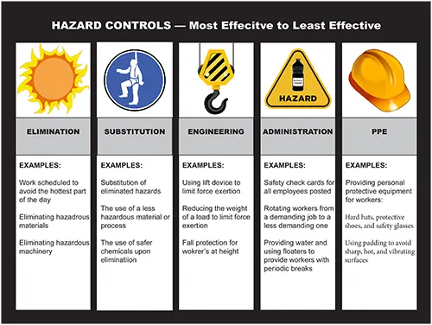
How will competitors be marked?
For this activity, the competitors will be marked as such:
• Identify 4 hazards 1% (total of 4%)
• Explain controls for the 4 hazards 1% (total of 4%)
• Complete a risk assessment 15%
• Develop a safe work procedure 12%

Slide 8
OHS Research – Written Presentation
One method of communicating health and safety information is through written and oral communication.
For this activity:
• The competitor will perform the role of an OHS professional researching an OHS issue at a workplace, in order to develop recommendations to the employer.
• The competitor will be assigned an OHS issue, which they will research, and for which they will develop recommendations.
• Once the recommendations have been developed, the competitor will be provided a document where the recommendations will be written.
• The written presentation of the recommendations will then be submitted to the judges for evaluation who will represent a workplace employer. The competitor will then verbally present the information to the judges. No electronic devices will be used during the verbal presentation.
• Electronic devices are required for this activity – competitors must use a tablet / laptop /computer to research and develop the recommendations.
• Each competitor will represent themselves as an OHS professional
• Competitors will be judged on how well they organize and communicate the key points

Slide 9
How will competitors be marked?
• Research/Content 5%
• Written report of recommendations 5%
• Verbal Presentation of recommendations 10%

Slide 10
Assessment – Point Breakdown
TASKS | /100
Hazard Identification | 40
Hazard Control | 40
OHS Research/Presentation | 20
Late Penalty | -5
Competition Ties:
In the event participant have a tied final score, the competitor with highest score in the Hazard Identification and Control portion will be declared the winner.

Slide 11
Equipment, Tools, & Supplies
PROVIDED BY THE COMMITTEE:
Clip Boards
Pencils
Hard Hats (if required by task)
Safety Vests
Safety Glasses
PROVIDED BY THE COMPETITOR:
Laptop/Tablet
Closed toe shoes
Note: Committee will provide laptops/tablets if required, but participants are encouraged to bring their own.

Slide 12
Safety Requirements
Safety awareness/requirements will be maintained at the minimum industry standards at all times.
A participant will be unable to compete in the Hazard Identification and Risk Assessment portion of the competition without:
Hi visibility vest, &
Closed toe footwear.
Note: All PPE will be provided for the participant during the competition.

Slide 13
Technical Chair and Judges
Technical Chair:
Vicki Lloyd, CRSP
WSCC Yellowknife, Senior OHS Officer
Email: vicki.lloyd@wscc.nt.ca
Phone: 867-669-4424
Judges:
Leon Haniliak
WSCC OHS Trainee
Bryson Cochrane
WSCC OHS Officer
Calvin Roberts
WSCC Inspector

